Slide 1
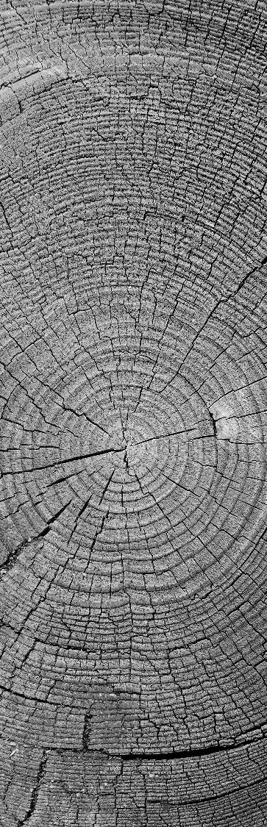

Under the Esteemed Guidance of
Dr. Pramod Sethy
Krishna Engineering College,
Ghaziabad – 201007
TRAFFIC SIGN DETECTION USING COMPUTER VISION
“Changes call for Innovation & Innovation leads to Progress”
Notes:
‹#›

Slide 2
MEMBERS OF TEAM
Kartik Jain, 1716110091
Eraa, 1716110070
Mayank Vats, 1716110115
Mayank Sinha, 1716110114
‹#›
Notes:
‹#›

Slide 3
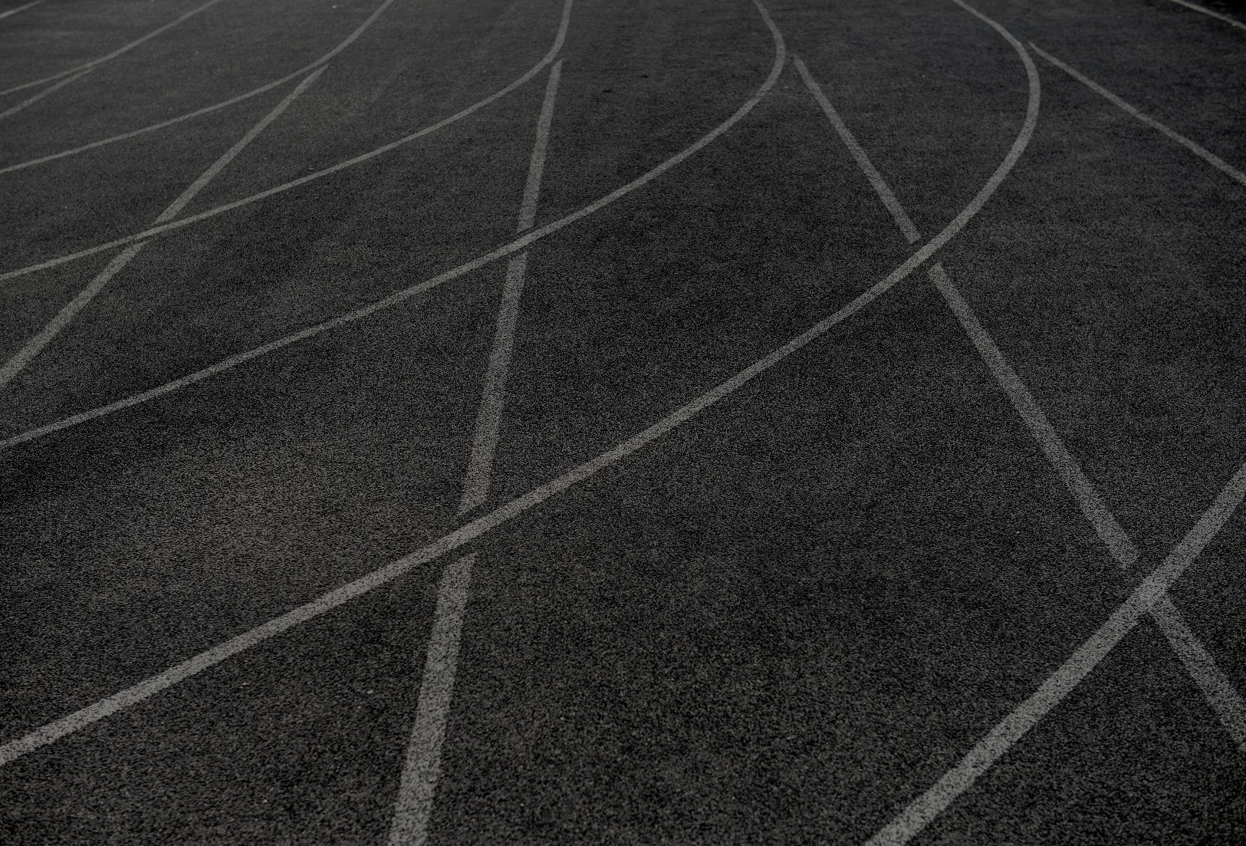
INTRODUCTION
In today’s world, almost everything we do has been simplified by automated tasks. In an attempt to focus on the road while driving, drivers often miss out on signs on the side of the road, which could be dangerous for them and for the people around them. This problem can be avoided if there was an efficient way to notify the driver without having them to shift their focus. Traffic Sign Detection plays an important role here by detecting a sign, thus notifying the driver of any upcoming signs. This not only ensures road safety, but also allows the driver to be at little more ease while driving on tricky or new roads. Another commonly faced problem is not being able to understand the meaning of the sign. With the help of this Advanced Driver Assistance Systems (ADAS) application, drivers will no longer face the problem of understanding what the sign says.
‹#›
Notes:
‹#›

Slide 4

PROPOSED SYSTEM
The system we propose in this paper is sectioned into two phases: detection and recognition. The detection phase simply discovers a sign from the environment. When a car is moving at a certain speed, the camera captures the environment, and our algorithm checks to see if a sign is present in that frame or not. Detecting the traffic sign is based on color and shape. In the recognition phase, the proposed algorithm classifies the detected sign. This is achieved with the help of a Convolutional Neural Network ensemble.
‹#›
Notes:
‹#›

Slide 5
DETECTION
In this phase, the image obtained from the camera in the car is preprocessed before the process of detection starts. General preprocessing steps involve converting the obtained RGB image into an HSV image. For detection, the HSV (Hue Saturation Value) color space is preferred over the RGB (Red Green Blue) color space. HSV is more similar to what the human eye actually sees when compared to an RGB image. An RGB image defines colors in terms of three primary colors, whereas HSV has a greater range of colors. An HSV image is also less susceptible to external light changes. The HSV image is equalized to adjust the contrast in the image by modifying the image’s histogram. Once the HSV image is obtained, the next steps would be to detect objects based on their color followed by finding out their shape and validating the object to be a traffic sign.

Slide 6
RECOGNITION
Once the sign is detected, the sign must also be classified. With the help of Google’s open source machine learning framework, TensorFlow, a convolutional neural network can be implemented. In our implementation of the recognition phase, the first step was to take the detected sign from the previous phase and perform basic preprocessing on the image. Training and testing of the CNN is the most important part of this phase. We used the German Traffic Sign Benchmark and the Belgium Traffic Signs data set for training and testing. A convolutional neural network is very similar to the brain in the sense that it also has neurons which in turn have weights and biases. Each neuron receives an input on which it performs some operation and the output is passed as the input to the next neuron. A convolutional neural network can have many layers, the first always being the input layer and the last the output layer. Anything else in between is called a hidden layer.

Slide 7
HOW DOES IT WORK?
Color Based Detection The first and most important thing we notice in a sign is the color. Once we see the color red, we realize that the board on the side of the road is actually a traffic sign. This is the same logic we used while proposing our method of detection. From the captured frames, the proposed algorithm knows to check for a sign based on the color red. If a portion of the image falls under the appropriate threshold of red, that part is checked to see if a sign is available. Once the red threshold is verified, the contours of the red part are found.
Shape Based Detection The number of edges is calculated using the contours discovered in the previous step. This is done using the Douglas Peucker algorithm [4]. In this paper, we talk about 2 shapes: triangle, circle. Once the number of edges is found using the Douglas-Peucker algorithm, the area of the contour is also found. If the number of edges found is 3, and the area satisfies the minimum condition, it is considered to be a sufficiently large triangle. Similarly, if the number of edges found is greater than or equal to 6, and the area of the contour follows the minimum condition, the contour is considered to be a sufficiently large circle.

Slide 8
Once the shapes are found, finding the bounding box is key. The bounding box separates the Region of Interest (ROI) from the rest of the environment. The bounding box usually touches the outer triangle or circle of the detected contour. For a triangular sign, there are two triangles, the outer triangle, which touches the bounding box and the inner triangle which is inside the outer triangle and does not touch the bounding box.
3) Sign Validation Once the bounding box is found, the sign must be validated. The image on which a threshold filter has been applied is first inverted where the inner triangle which was previously black is now white and the outer triangle which was previously white is now black. If the white triangle touches the boundary, then it is not a sign, and if it does not touch the outer triangle and the boundary box, it is considered to be a traffic sign. This is resized to 48x48 and set to the next phase. To indicate where the sign is, a green contour is drawn around the detected sign. As seen in Fig. 2(b), the detected sign is highlighted with a green border. OpenCV was used to perform all the above-mentioned preprocessing steps.

Slide 9
PROJECT DESIGN
The basic steps of the project are as follows:
Load the data set
Explore, summarize and visualize the data set
Design, train and test a model architecture
Use the model to make predictions on new images
Analyze the soft max probabilities of the new images
The dataset we’ll be using to train our own custom traffic sign classifier is the German Traffic Sign Recognition Benchmark (GTSRB).
The GTSRB dataset consists of 43 traffic sign classes and 39,209 images.
Link of Code for Recognition :
https://github.com/kartikjain-sudo/Traffic-Signal-Classifier

Slide 10
FUTURE SCOPE
While the model proposed in this paper does bring us a step closer to achieving the ideal Advanced Driver Assistance System or even a completely driverless system, there is a lot that can be improved. For identification of a sign, this paper depends on color and shape of the sign. This is a problem if there is a reflection on the sign which impacts its color. Similarly, if the sign is chipped or cut off, the shape of the sign is impaired, thus resulting in no detection of the sign. Another important issue to consider is detection in the night. If the camera is not able to capture the environment in the night due to the darkness, the sign cannot be detected and classified. A text to speech module can also be added to this application. In the current application, the driver would have to read the text printed on the classified sign, but with the help of a voice module, more comfort is guaranteed. The overall performance could also be improved and customized with the help of more datasets and from different countries.

Slide 11
THANK YOU
Notes:
‹#›

